Slide 1
What Are Kubernetes Volumes?
A Kubernetes volume is a directory containing data, which can be accessed by containers in a Kubernetes pod. The location of the directory, the storage media that supports it, and its contents, depend on the specific type of volume being used.
Volumes are defined in the .spec.containers[*].volumeMounts field of the pod template. For each pod and each container image within the pod, you need to specify which volumes it will mount and on which paths (the paths can be different for each container).

Slide 2
Emptydir
An emptyDir volume is created when Kubernetes assigns a pod to a node. The lifespan of this volume is tied to a pod's lifecycle existing on that specific node. An emptyDir volume recreates when containers restart or crash. However, the data in this volume is deleted and lost when the pod is removed from the node, crashes, or dies.
After creating an emptyDir volume, you can declare the volume type name as a field in the pod manifest file. It shows under the volume property section with empty curly braces{} as the value. EmptyDir volumes are suitable mainly for temporary data storage.

Slide 3
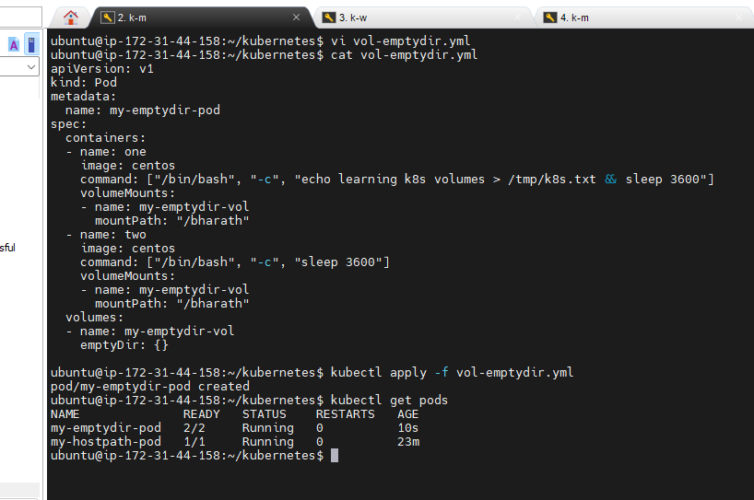
Emptydir (Volume inside the pod )

Slide 4
Emptydir Script
apiVersion: v1
kind: Pod
metadata:
name: my-emptydir-pod
spec:
containers:
- name: one
image: centos
command: ["/bin/bash", "-c", "echo learning k8s volumes > /tmp/k8s.txt && sleep 3600"]
volumeMounts:
- name: my-emptydir-vol
mountPath: "/bharath"
- name: two
image: centos
command: ["/bin/bash", "-c", "sleep 3600"]
volumeMounts:
- name: my-emptydir-vol
mountPath: "/bharath"
volumes:
- name: my-emptydir-vol
emptyDir: {}

Slide 5
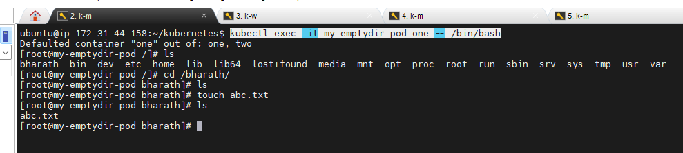
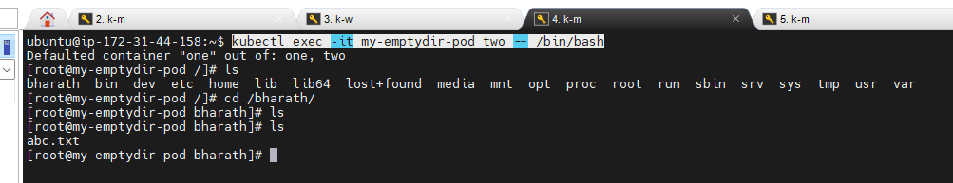
Go inside the containers and create some files and check in the other container
The files are Replicated

Slide 6
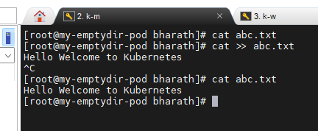
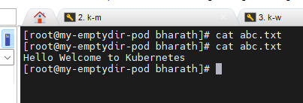
Appending the content inside the file
The content is Replicated inside the file

Slide 7
Hostpath
A hostPath volume mounts a file or directory on the worker node into the container's filesystem. hostPath volumes are the first type of persistent storage we're introducing, because the emptyDir volumes' contents get deleted when a pod is turn down, whereas a hostPath volume's contents don't.

Slide 8
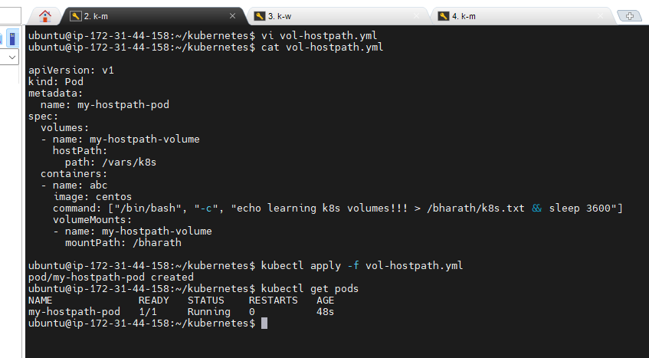
Hostpath (Volume inside the pod outside the node)

Slide 9
Hostpath Script
apiVersion: v1
kind: Pod
metadata:
name: my-hostpath-pod
spec:
volumes:
- name: my-hostpath-volume
hostPath:
path: /vars/k8s
containers:
- name: abc
image: centos
command: ["/bin/bash", "-c", "echo learning k8s volumes!!! > /bharath/k8s.txt && sleep 3600"]
volumeMounts:
- name: my-hostpath-volume
mountPath: /bharath

Slide 10
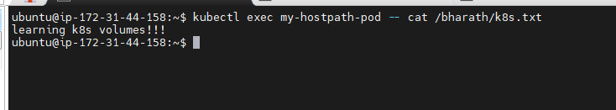
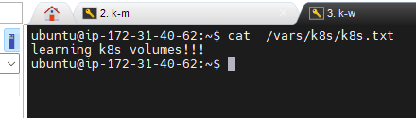
The data inside the container is replicated on the Node

Slide 11
Persistent Volume
Managing storage is a distinct problem from managing compute instances. The PersistentVolume subsystem provides an API for users and administrators that abstracts details of how storage is provided from how it is consumed. To do this, we introduce two new API resources: PersistentVolume and PersistentVolumeClaim.
A PersistentVolume (PV) is a piece of storage in the cluster that has been provisioned by an administrator or dynamically provisioned using Storage Classes. It is a resource in the cluster just like a node is a cluster resource. PVs are volume plugins like Volumes, but have a lifecycle independent of any individual Pod that uses the PV. This API object captures the details of the implementation of the storage, be that NFS, iSCSI, or a cloud-provider-specific storage system.

Slide 12
A PersistentVolumeClaim (PVC) is a request for storage by a user. It is similar to a Pod. Pods consume node resources and PVCs consume PV resources. Pods can request specific levels of resources (CPU and Memory). Claims can request specific size and access modes (e.g., they can be mounted ReadWriteOnce, ReadOnlyMany or ReadWriteMany).
While PersistentVolumeClaims allow a user to consume abstract storage resources, it is common that users need PersistentVolumes with varying properties, such as performance, for different problems. Cluster administrators need to be able to offer a variety of PersistentVolumes that differ in more ways than size and access modes, without exposing users to the details of how those volumes are implemented. For these needs, there is the StorageClass resource.

Slide 13
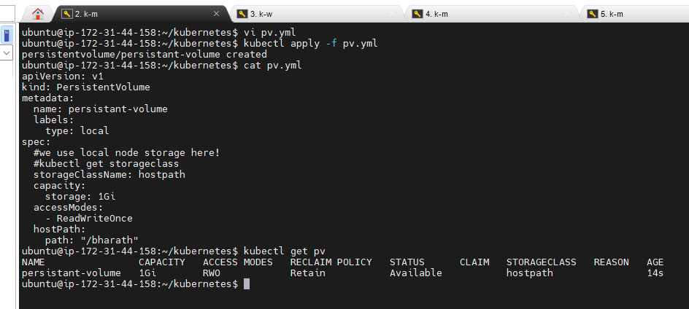
PersistentVolume(Using hostpath )

Slide 14
PersistentVolume Script
apiVersion: v1
kind: PersistentVolume
metadata:
name: persistent-volume
labels:
type: local
spec:
#we use local node storage here!
#kubectl get storageclass
storageClassName: hostpath
capacity:
storage: 1Gi
accessModes:
- ReadWriteOnce
hostPath:
path: "/bharath"

Slide 15
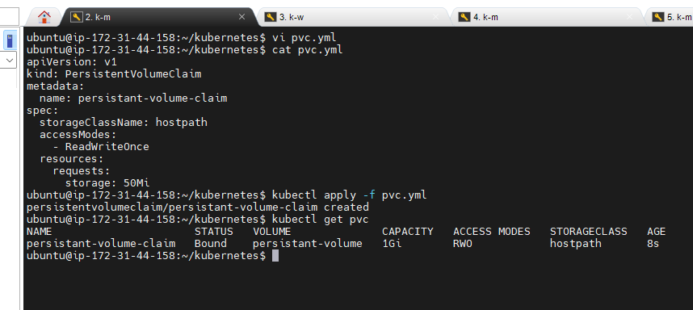
PersistentVolumeClaim

Slide 16
PersistentVolumeClaim Script
apiVersion: v1
kind: PersistentVolumeClaim
metadata:
name: persistent-volume-claim
spec:
storageClassName: hostpath
accessModes:
- ReadWriteOnce
resources:
requests:
storage: 50Mi

Slide 17
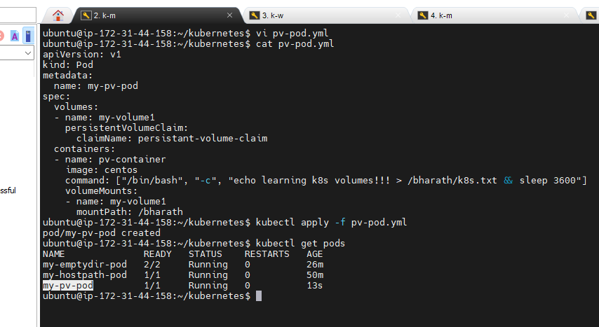
Using PersistentVolume Creating Pod

Slide 18
Script For Creating Pod Using PersistentVolume
apiVersion: v1
kind: Pod
metadata:
name: my-pv-pod
spec:
volumes:
- name: my-volume1
persistentVolumeClaim:
claimName: persistent-volume-claim
containers:
- name: pv-container
image: centos
command: ["/bin/bash", "-c", "echo learning k8s volumes!!! > /bharath/k8s.txt && sleep 3600"]
volumeMounts:
- name: my-volume1
mountPath: /bharath

Slide 19
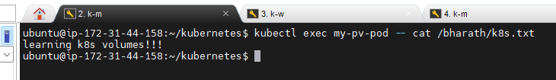
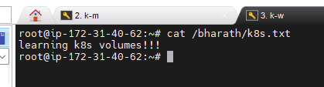
The data inside the container is replicated on the Node

Slide 20
PersistentVolume (Using nfs)
One of the most useful types of volumes in Kubernetes is nfs.
NFS stands for Network File System – it's a shared filesystem that can be accessed over the network.
The NFS must already exist – Kubernetes doesn't run the NFS, pods in just access it.
An NFS is useful for two reasons.
What's already stored in the NFS is not deleted when a pod is destroyed. Data is persistent.
An NFS can be accessed from multiple pods at the same time. An NFS can be used to share data between pods!
This is really useful for running applications that need a filesystem that’s shared between multiple application servers.

Slide 21
PersistentVolume (Using nfs)→(Volume outside the node)
NFS-Server→ Launch an ec2-instance Ubuntu and run the following commands to install the NFS-Server
- sudo apt update
- sudo apt install nfs-kernel-server
- sudo mkdir -p /mnt/nfs_share
- sudo chown -R nobody:nogroup /mnt/nfs_share/
- sudo vim /etc/exports
- insert this content to /etc/exports
/mnt/nfs_share *(rw,sync,no_subtree_check)
if you face any security issues then use below content
/mnt/nfs_share *(rw,sync,no_subtree_check,insecure)
- sudo exportfs -a
- to check exports
sudo exportfs -v or showmount -e
- sudo systemctl restart nfs-kernel-server

Slide 22
NFS-Client (in Worker Nodes)
- sudo apt install nfs-common
- showmount -e nfs-server-ip

Slide 23
PersistentVolume Script
apiVersion: v1
kind: PersistentVolume
metadata:
name: pv-nfs-pv1
labels:
type: local
spec:
storageClassName: manual
capacity:
storage: 1Gi
accessModes:
- ReadWriteMany
nfs:
server: 172.31.40.166
path: "/mnt/nfs_share"

Slide 24
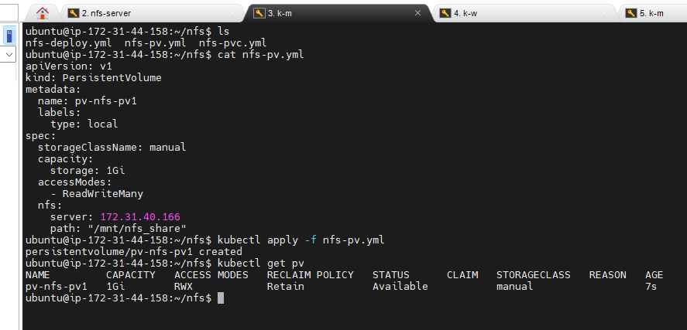
PersistentVolume

Slide 25
PersistentVolumeClaim Script
apiVersion: v1
kind: PersistentVolumeClaim
metadata:
name: pvc-nfs-pv1
spec:
storageClassName: manual
accessModes:
- ReadWriteMany
resources:
requests:
storage: 500Mi

Slide 26
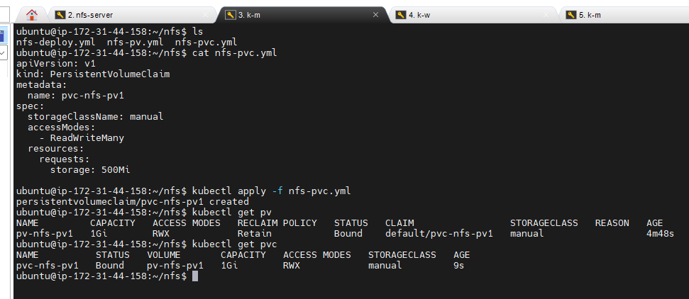
PersistentVolumeClaim

Slide 27
apiVersion: apps/v1
kind: Deployment
metadata:
labels:
run: nginx
name: nginx-deploy
spec:
replicas: 1
selector:
matchLabels:
run: nginx
template:
metadata:
labels:
run: nginx
spec:
volumes:
- name: www
persistentVolumeClaim:
claimName: pvc-nfs-pv1
containers:
- image: nginx
name: nginx
volumeMounts:
- name: www
mountPath: /usr/share/nginx/html
Script For Creating Deployment Using PersistentVolume

Slide 28
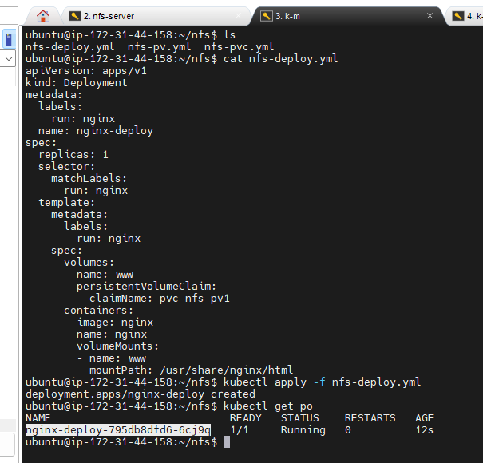
Script For Creating Deployment Using PersistentVolume

Slide 29
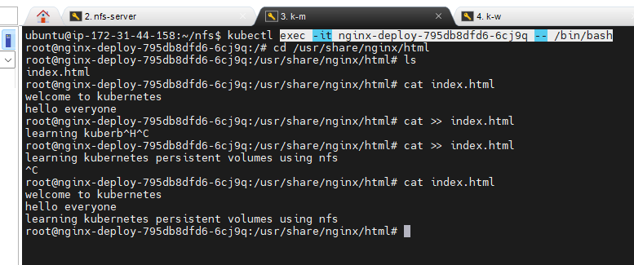
Go inside the pod and go to the mount location and add some content

Slide 30
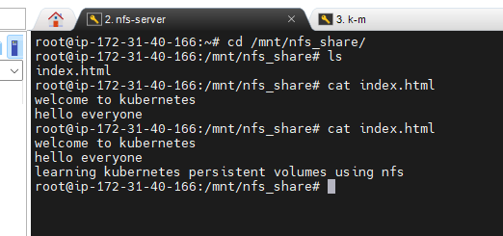
Go to the nfs-server and go to mount location and check the data is Replicated

Slide 31
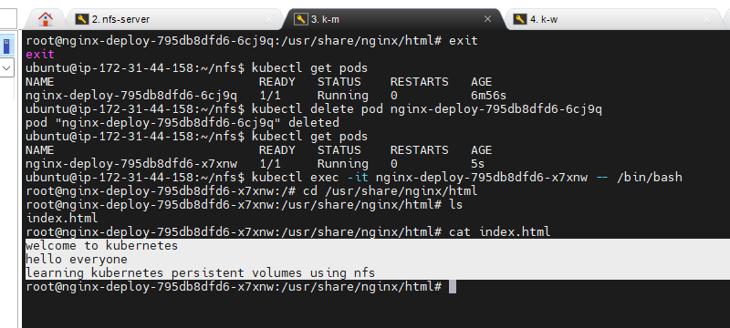
Now exit from the pod and delete the pod manually.
The deployment will spin up another pod and the same data is replicated inside the pod.

Slide 32
Thankyou…

